Slide 1

Overview and Data Science or Science of Data
Brian Wright, PhD
brianwright@virginia.edu
Assistant Professor
Data Science Institute

Slide 2
Outline
Capstones Q & A
Class Administration and Connection to Capstones
What is Data Science?

Slide 3
Class Administration/Tech Stack
Syllabus and files are on Github
https://github.com/NovaVolunteer/Practice_Application_DS
Use Collab for submission of graded material
Slack Channel:
Use for exchanging ideas, sharing interesting content or asking questions
Class is directly linked to your Capstone
Apply the content to development of the capstone project
Review Schedule and Requirements
Trello

Slide 4
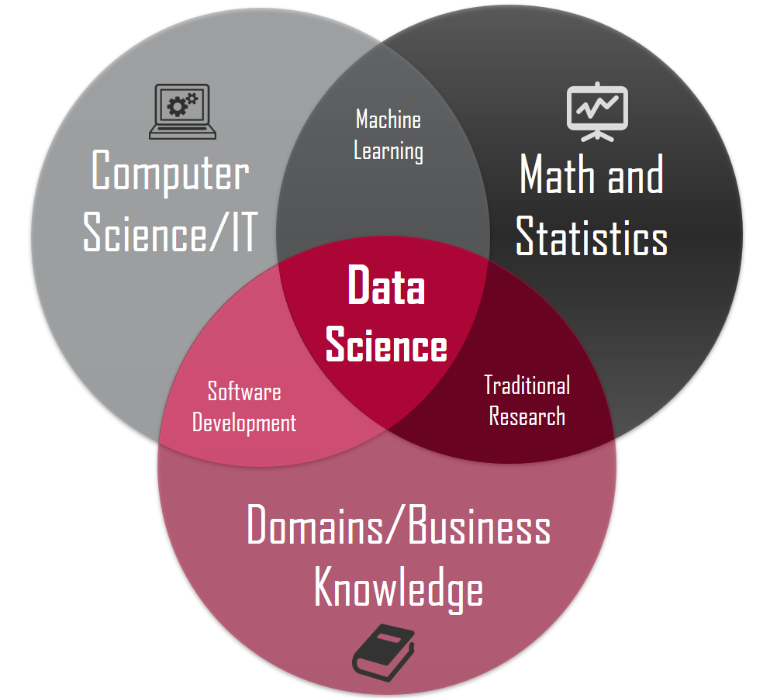
Data Science Overview
What is Data Science?
X
X
X
Source: https://honingds.com/blog/intro-to-data-science/

Slide 5
Data Science Overview
Why the surge in Data Science?
Increases in Computing Power - Processor Speed/Cloud Computing
Availability of Data – Storage Capacity
Open Source Tools – Incredibly dedicated and heavily vested communities supporting technology advancement

Slide 6
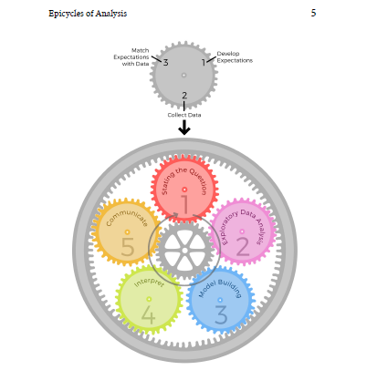
Data Science Overview
Roger Ping: Art of Data Science

Slide 7
7
6
2
5
3
4
http://sudeep.co/data-science/Understanding-the-Data-Science-Lifecycle/

Slide 8
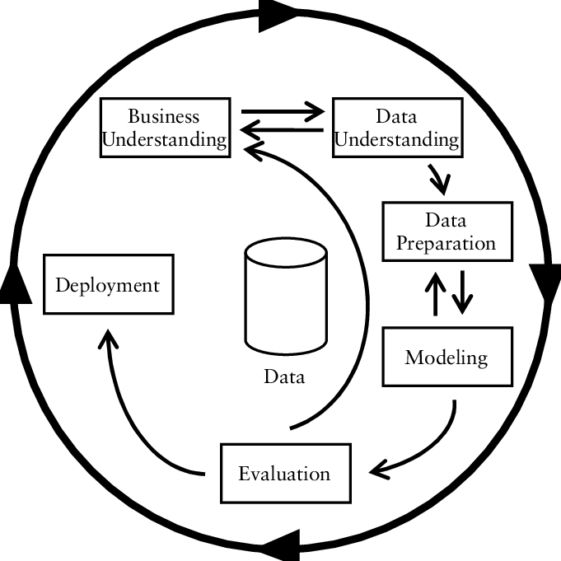
Data Science Overview
CRISP-DM
https://www.researchgate.net/figure/CRISP-DM-process-model_fig3_261307514

Slide 9
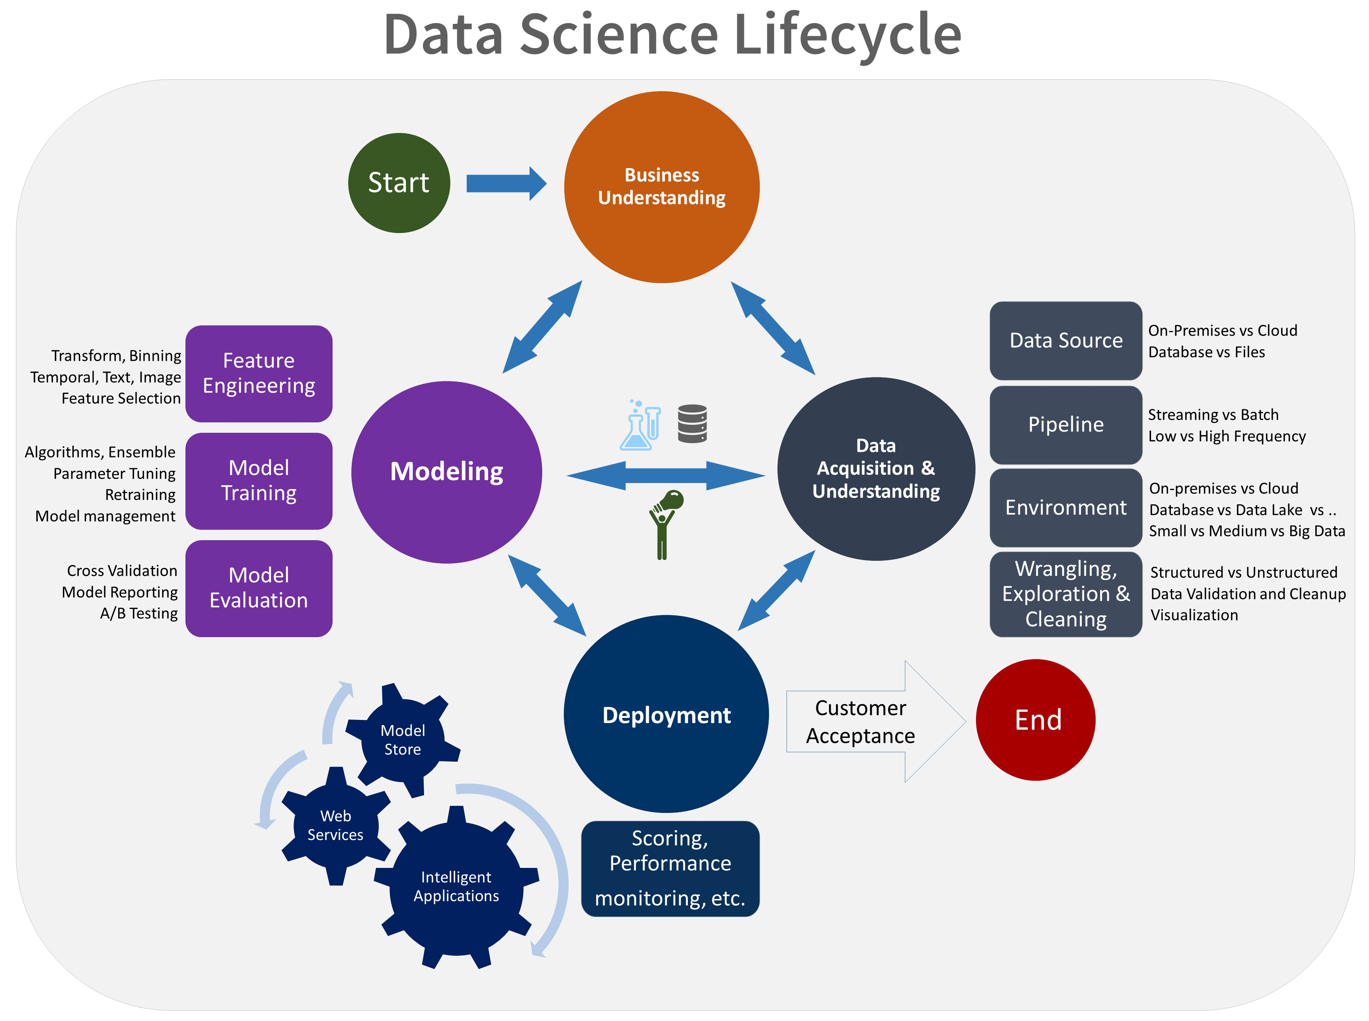
Microsoft
https://jenstirrup.com/2017/07/01/whats-wrong-with-crisp-dm-and-is-there-an-alternative/

Slide 10
Exercise: What you think? Get in Groups of Five What about these makes sense, what doesn’t and what would you draw…

Slide 11
LIFECYCLE OF THE CLASS
Question Development/Business Understanding
Project Charter
Project Proposal
Data Acquisition/Storage
Modelling Building
Data Exploration
Communications
Data Cleaning
Feature Engineering
Capstone Poster
Group Paper SEEDS
Group Presentations
Group Presentations
Final Presentations

Slide 12
Epicycle of Data Science
Setting Expectations,
Collecting information (data), comparing the data to your expectations, and if the expectations don’t match,
Revising your expectations or fixing the data so your data and your expectations match.

Slide 13
Data Science Overview
Match Expectations with Data
Develop Expectations
3
1
2
Can be the hardest, maybe not the most time consuming
Collect Data
Stating the Question

Slide 14
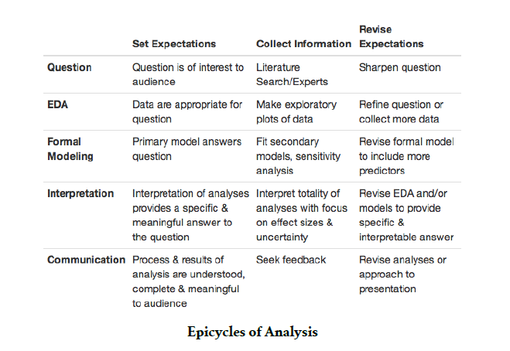
Epicycle at Each Stage

Slide 15
Research Practices Key to Question Definition/Expectations

Slide 16
Research Techniques
Create an informal Literature Review or business case review for the central topic of the issue being addressed
Subscribe to online journals or newsletters
Stay current with policy or regulatory changes in your field

Slide 17
Research Techniques
Have discussions with peers
Pull information from your previous work
Membership in professional groups
Attend conventions or training sessions

Slide 18
Research Techniques
Seek additional educational opportunities (brick and mortar or online)
Subscribe to subject specific listservs
Meet with a Librarian

Slide 19
Literature/Research Review
Gathering information on your question in a structured manner
Create an outline of sources
Reduce resources to key sources
Summarize the themes of these elements

Slide 20
Research Outcomes
Gives your recommendations and insight substance
Increases your value as a knowledge worker
Makes your organization more competitive from an intellectual capital standpoint
Allows for you to provide the maximum amount of value in your chosen field
Allows to become ever more specialized
Stay on top of the latest trends and insights
Creates a foundation for intuition and critical thinking in your chosen field

